Slide 1

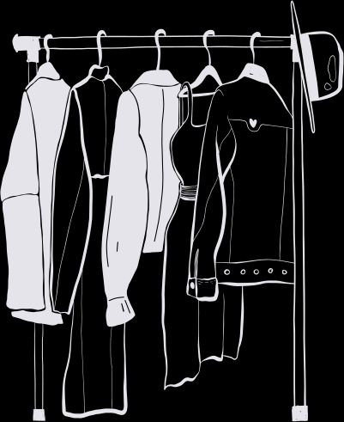


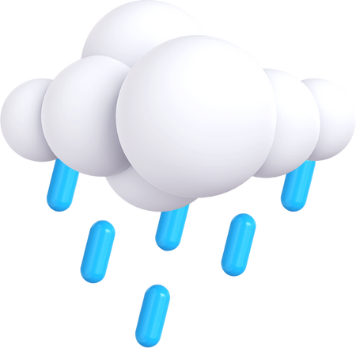


WEATHER WEAR
Presented By Team - 3
Bad Ideas

Slide 2


AGENDA
1
Team Members Roles and Responsibilities
7
13
Stories not completed
Technologies
2
Improvements made from Professor Feedback
8
14
Algorithms
Metrics
15
Retrospective
3
9
Project Description
Diagrams
16
Sprint 2
4
Team Working Agreement
10
Product backlog
17
8
Project Demo
5
11
Personas
Test Cases
18
Github Link
6
6
MVP
12
Stories Completed
19
Live Application Demo

Slide 3




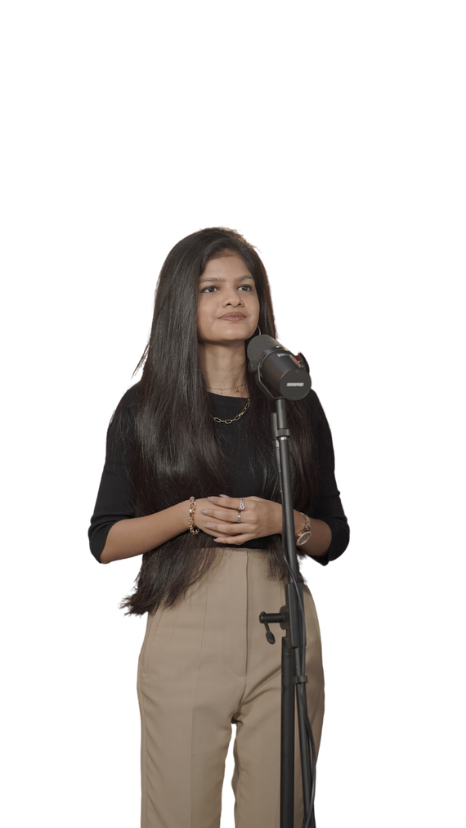
THIS IS OUR TEAM
Helloween James
Gracia Betty Jebaraj Daniel
Tejaswini Kandyala
Project Manager & Machine Learning Engineer
Frontend Developer
Frontend Developer & UI/UX Designer

Slide 4

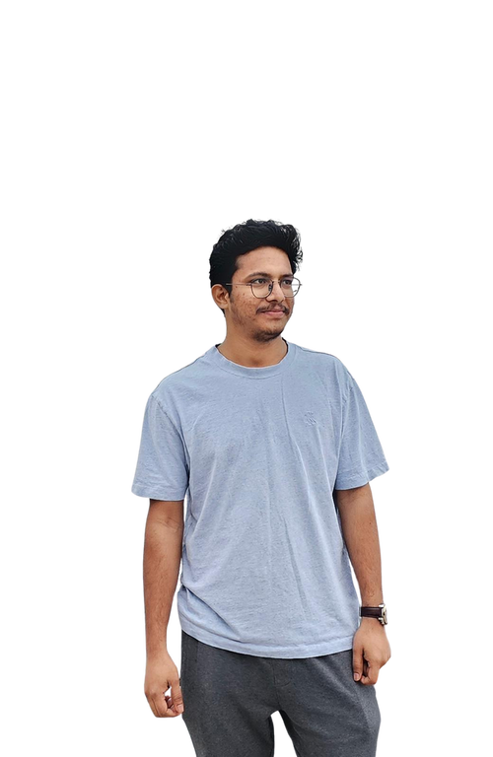

THIS IS OUR TEAM
Bharadwaj Reddy Asireddy
Mohith Durga Srinivas Tripuramallu
Sai Rajeswari Ghanta
Backend Developer & UI/UX Designer
Quality Assurance Tester
Backend Developer

Slide 5

Improvements made from professor feedback
Tools Alignment:
Adjusted the alignment of tools on the wikipage for improved readability and user experience, based on feedback.
Sprint planning:
Transitioned from a 2-day project schedule in the last sprint to a detailed sprint plan, visualized with a supporting graph for better tracking and transparency.

Slide 6
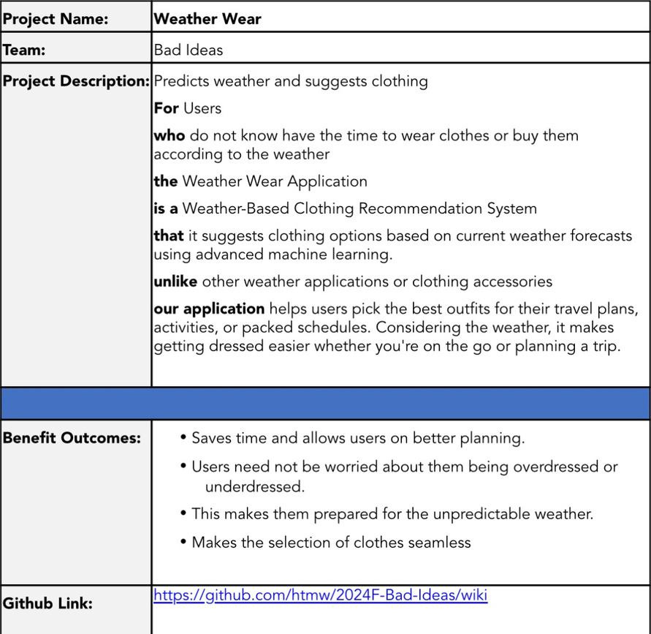
PROJECT DESCRIPTION

Slide 7

TEAM AGREEMENT
1. Team Information
· Project Title: Weather Wear
· Team Name: Bad Ideas
· Team Members and Roles :
Helloween James – Project Manager & Machine learning engineer
Gracia Betty Jebaraj Daniel – Front-end developer & UI/UX Designer
Tejaswini Kandyala – Front-end developer
Mohith Durga Srinivas Tripuramallu – Back-end Developer
Bharadwaj Reddy Asireddy - Back-end Developer & UI/UX Designer
Sai Rajeswari Ghanta - Quality Assurance (QA) Tester
2. Meetings and Communication
We will meet twice a week and we shall use what’s app, email, outlook and Zoom as our communication for any updates and response should be within 2-3hrs.
3. Work Distribution
Everyone in the team agrees to share the work equally and if any member fells overwhelmed, we will redistribute the tasks.

Slide 8
TEAM AGREEMENT
4. Conflict Resolution
· If we have any sort of disagreement in the tasks, we’ll talk it through vote.
· If the conflict cannot be resolved internally, we will reach professor for an advice
5. Deadlines
· We will set deadlines for each task and everyone agrees to stick to them and if someone can’t meet a deadline, they should inform the team in advance.
· We agree to submit everything on time, with everyone’s contribution.
6. Signatures
· Gracia Betty Jebaraj Daniel
· Tejaswini Kandyala
· Helloween James
· Mohith Durga Srinivas Tripuramallu
· Bharadwaj Reddy Asireddy
· Sai Rajeswari Ghanta

Slide 9

PERSONAS

Slide 10

HANNAH
This is Hannah, Age 28. She stays in New York City, NY and she is Product Manager.
Life Style: She commutes everydays and she meets a lot of clients.
Weather and Clothing: NYC weather is totally unpredictable as it can rain, be sunny or be cold anytime. She likes wearing formal clothes.
Technology usage: She loves trying out new apps.
She is busy person and always wears uncomfortable dress which does not align well with weather, so she needs something which can set her to wear clothes which doesn't waste her time.

Slide 11

JASON
This is Jason, Age 34. He stays in Seattle, WA, and he is a Software Engineer.
Life Style: He commutes to the office twice a week and enjoys biking when the weather permits.
Weather and Clothing: Seattle's weather is unpredictable, with frequent rain and sudden changes. He prefers casual and comfortable clothing but often finds himself either underdressed for cold weather or overdressed when it warms up unexpectedly.
Technology usage: He is tech-savvy and enjoys trying out new apps to improve efficiency.
He frequently faces issue with choosing the right clothes due to the constant change in weather and he needs a solution that helps him dress appropriately for the day.

Slide 12

ANANYA
This is Ananya, Age 22. She stays in Mumbai, India, and she is a College Student.
Life Style: She walks around campus a lot, balancing her classes, internships, and extracurricular activities.
Weather and Clothing: Mumbai's weather can be unpredictable, with sudden rain showers or humid heat. She likes trendy, comfortable clothes but struggles to dress appropriately when the weather changes quickly.
Technology usage: She uses multiple apps to manage her busy schedule and lifestyle.
She often finds herself either drenched in rain or overheated due to sudden weather changes and needs something that will help her choose the right outfit for the day without wasting time.

Slide 13

Minimum Viable Product
Location-Based Weather Data: Fetch and display real-time weather.
Outfit Suggestions: Recommend outfits based on weather.
Future Outfit Planning: Plan outfits for future dates.
User Preferences: Customize outfit recommendations.
Responsive Design: Optimized for mobile and desktop.

Slide 14



TECHNOLOGIES
Frontend
Backend
Database
Next JS
Shadcn
Tailwind CSS
Flask
Open weather API
MongoDB

Slide 15
TECHNOLOGIES
Deployment
Machine Learning
Tools
Figma
VSCode
Codespaces
Github
Postman
Vercel
AWS
Scikit Learn
Pytorch

Slide 16


ABOUT FRONTEND TECHNOLOGIES
So here next js is used for building the website because next js is one of the best frontend frameworks and with integration with shadcn and tailwind css, building minimalistic website easier.

Slide 17

ABOUT BACKEND TECHNOLOGIES
RapidAPI offers a variety of weather APIs that provide all the data you could need. These APIs are great for delivering accurate and up-to-date weather information.
For our project, we chose one of these weather APIs from RapidAPI to boost our data capabilities.

Slide 18

ABOUT DATABASE TECHNOLOGIES
MongoDB is one the best NoSQL database and as the application data can also be unstructured, this would be best option to choose it. This also have fast retrieval ( read operations) compared to SQL databases, so this is better choice for this application.

Slide 19

ABOUT DEPLOYMENT TECHNOLOGIES
Here, first vercel is used for deploying the frontend part of the application and aws is used for deploying backend and machine learning as well because NextJS works seamless in vercel, as vercel are the one who developed Next js.

Slide 20

ABOUT MACHINE LEARNING TECHNOLOGIES
So here scikit learning is primarily used for building the basic version of the machine learning algorithms and in later on stages, Pytorch is used for build even more accurate version of the machine learning which understands the weather even more better and predicts it well.

Slide 21

ABOUT TOOLS TECHNOLOGIES
Figma is mainly used for prototyping and design how the product looks like. VSCode is where actually the code is written. Codespaces is where the collaboration code is done, for pair programming. Github is where whole code is hosted. Postman is for testing the API endpoints.

Slide 22
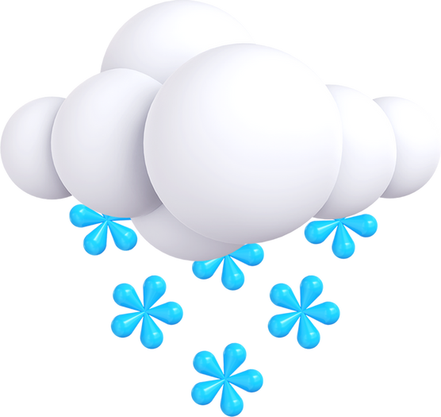
ALGORITHMS
Predicting Weather
Random forest regressor
Used to predict weather conditions like temperature or humidity by learning patterns from historical weather data through decision trees that capture non-linear relationships.
LSTM
A recurrent neural network used to predict future weather by capturing long-term dependencies and patterns in sequential weather data over time.
Recommendation
KNN (k-nearest neighbours)
Used to recommend outfits by finding similar users (or outfits) based on user preferences and weather conditions, suggesting clothing choices that worked for users with similar profiles or conditions.

Slide 23
DIAGRAMS

Slide 24
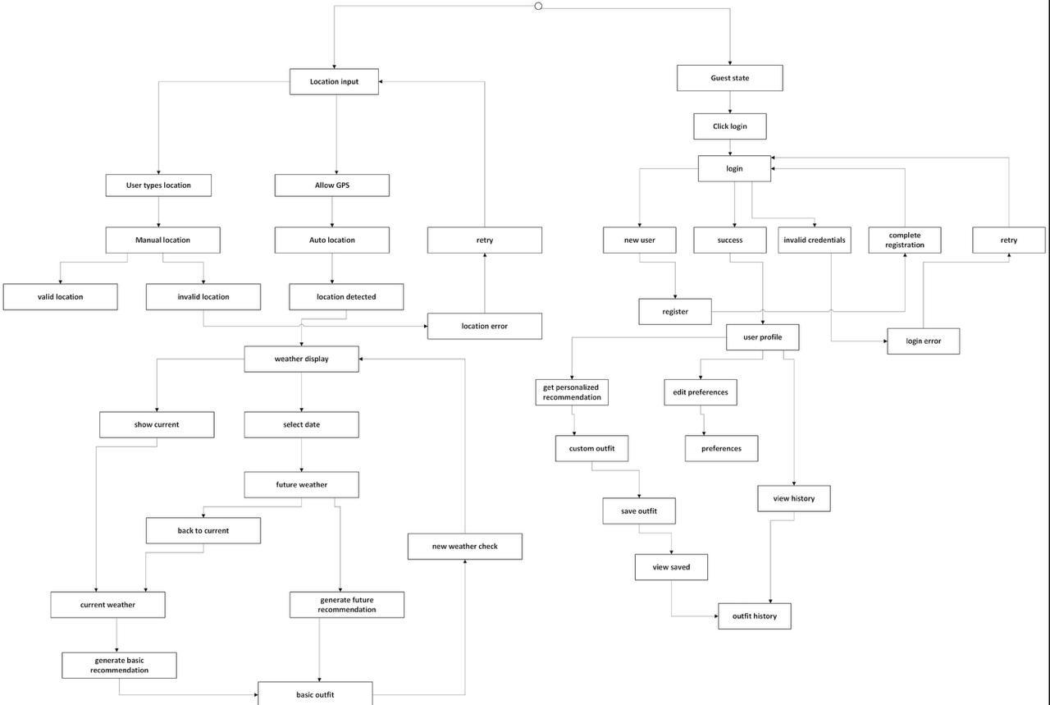
State Diagram

Slide 25
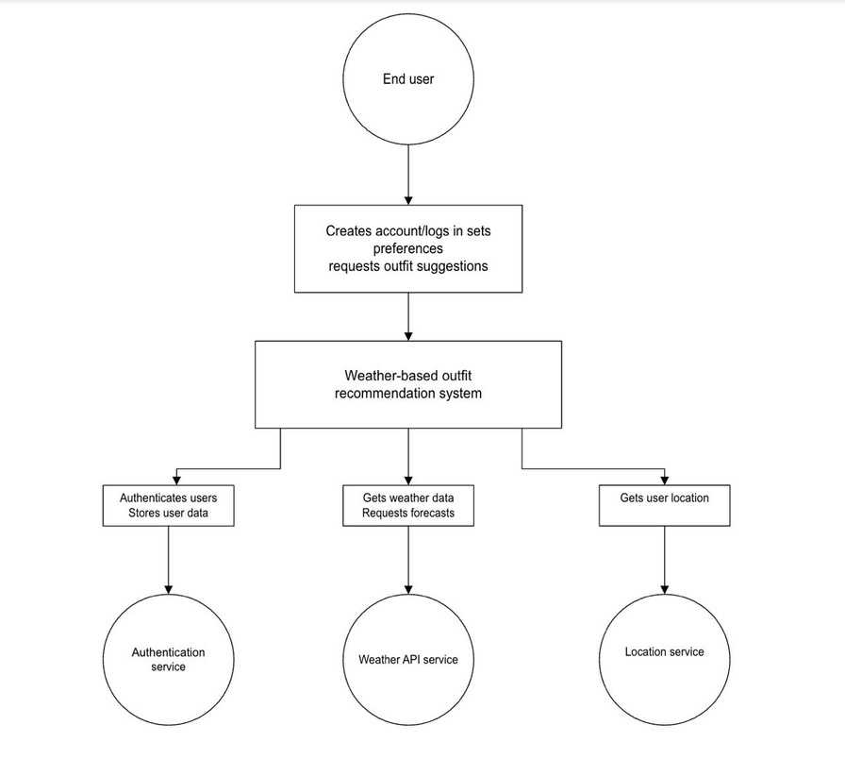
Context diagram

Slide 26
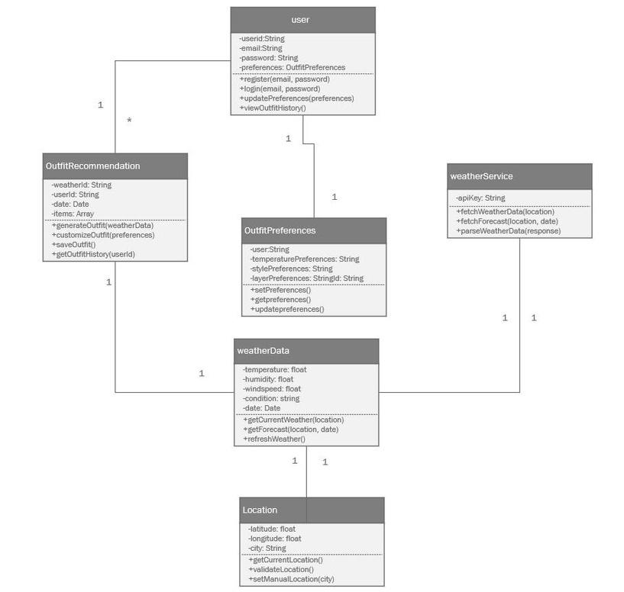
Class diagram

Slide 27
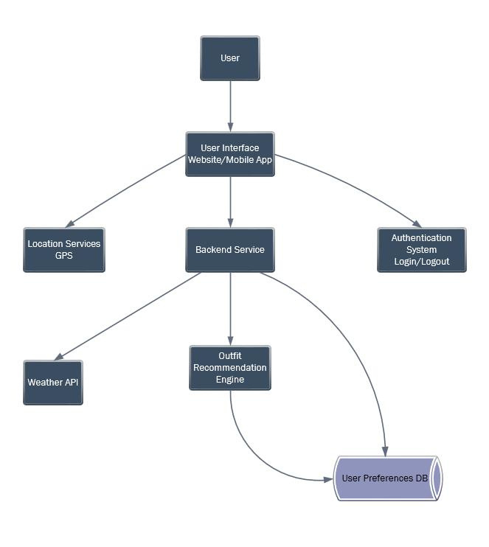
Architecture diagram

Slide 28
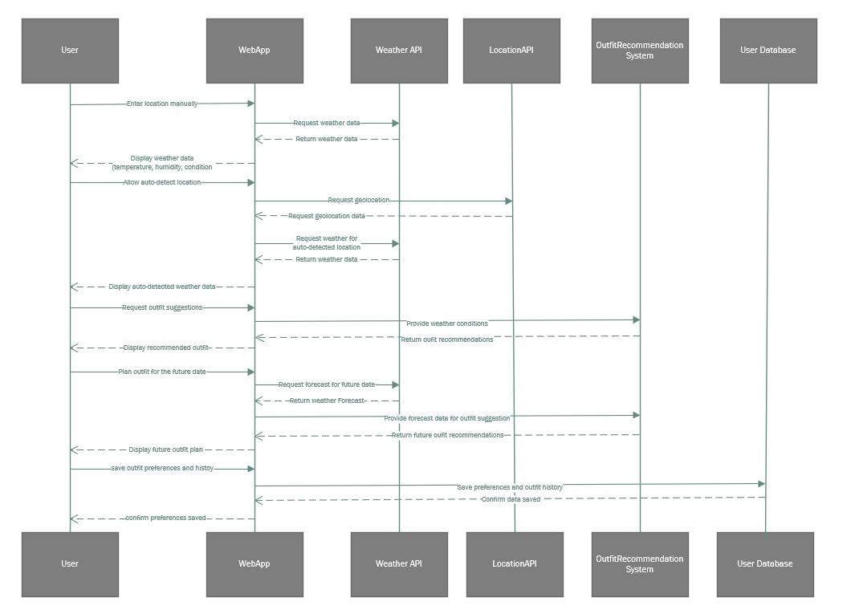
Sequence diagram

Slide 29
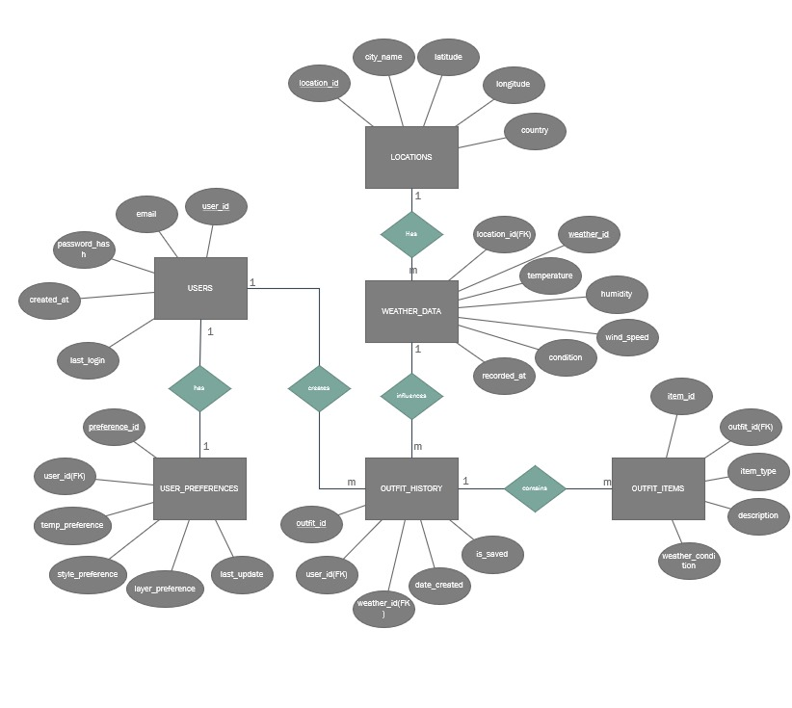
ER diagram

Slide 30
Product Backlog
Sprint | User Story/Technical Story | Acceptance Criteria
Sprint 1 | User Story 1: As a user, I want to input my current location to get real-time weather data. | Users can input their location manually.
Sprint 1 | User Story 1: As a user, I want to input my current location to get real-time weather data. | Users can choose from a list of predefined cities.
Sprint 1 | User Story 1: As a user, I want to input my current location to get real-time weather data. | The system retrieves and displays current temperature.
Sprint 1 | User Story 1: As a user, I want to input my current location to get real-time weather data. | The system retrieves and displays current humidity.
Sprint 1 | User Story 1: As a user, I want to input my current location to get real-time weather data. | The system retrieves and displays current weather condition.
Sprint 1 | User Story 1: As a user, I want to input my current location to get real-time weather data. | Handle invalid locations or errors gracefully.
Sprint 1 | User Story 2: As a user, I want the system to detect my location automatically so I can quickly get weather info. | Users have the option to allow location-based weather data.
Sprint 1 | User Story 2: As a user, I want the system to detect my location automatically so I can quickly get weather info. | The system requests geolocation permission.
Sprint 1 | User Story 2: As a user, I want the system to detect my location automatically so I can quickly get weather info. | The system retrieves weather data automatically.
Sprint 1 | User Story 2: As a user, I want the system to detect my location automatically so I can quickly get weather info. | Handle errors when location permission is denied.
Sprint 1 | User Story 3: As a user, I want to see basic weather details clearly on the homepage. | The homepage displays the temperature clearly.
Sprint 1 | User Story 3: As a user, I want to see basic weather details clearly on the homepage. | The homepage displays the humidity clearly.
Sprint 1 | User Story 3: As a user, I want to see basic weather details clearly on the homepage. | The homepage displays the wind speed clearly.
Sprint 1 | User Story 3: As a user, I want to see basic weather details clearly on the homepage. | The homepage displays the weather condition clearly.
Sprint 1 | User Story 3: As a user, I want to see basic weather details clearly on the homepage. | Ensure a simple and user-friendly layout.

Slide 31
Product Backlog
SPRINT | User Story/Technical Story | Acceptance Criteria
Sprint 1 | User Story 4: As a user, I want to refresh weather data manually. | Users can refresh the weather data via a refresh button.
Sprint 1 | User Story 4: As a user, I want to refresh weather data manually. | The page updates with the latest weather information.
Sprint 1 | User Story 5: As a user, I want the website to be responsive for mobile devices. | Ensure the website layout is responsive on desktop.
Sprint 1 | User Story 5: As a user, I want the website to be responsive for mobile devices. | Ensure the website layout is responsive on mobile devices.
Sprint 1 | User Story 5: As a user, I want the website to be responsive for mobile devices. | Weather data should be clearly visible on all devices.
Sprint 1 | Technical Story 1: Set up basic UI/UX design for weather data display. | Create a simple homepage with location input fields.
Sprint 1 | Technical Story 1: Set up basic UI/UX design for weather data display. | Create buttons for location input and refresh.
Sprint 1 | Technical Story 1: Set up basic UI/UX design for weather data display. | Display weather info in an organized, easy-to-read format.
Sprint 1 | Technical Story 2: Integrate a weather API to fetch real-time weather data. | Successfully fetch weather data from an external API.
Sprint 1 | Technical Story 2: Integrate a weather API to fetch real-time weather data. | Ensure API integration is stable.
Sprint 1 | Technical Story 2: Integrate a weather API to fetch real-time weather data. | Handle errors for invalid locations.

Slide 32
Product Backlog
Sprint | User Story/Technical Story | Acceptance Criteria
Sprint 2 | User Story 6: As a user, I want to receive an outfit suggestion based on the current weather conditions. | Display a recommended outfit for cold weather (e.g., coat).
 |  | Display a recommended outfit for warm weather (e.g., light clothes).
 |  | Adapt outfit suggestions based on rain.
 |  | Adapt outfit suggestions based on snow.
 |  | Adapt outfit suggestions based on wind.
Sprint 2 | User Story 7: As a user, I want to plan an outfit for a future date or journey. | Users can input a future date for weather forecast.
 |  | Display outfit suggestions based on future forecast.
 |  | Allow users to select time of day for more accurate planning.
Sprint 2 | User Story 8: As a user, I want to customize my outfit preferences based on my comfort level. | Users can set personal preferences for warmer outfits.
 |  | Users can set personal preferences for cooler outfits.
 |  | Tailor outfit recommendations based on preferences.

Slide 33
Product Backlog
Sprint | User Story/Technical Story | Acceptance Criteria
Sprint 2 | User Story 9: As a user, I want to receive clothing layer suggestions based on cold weather. | Provide layered clothing suggestions for cold weather.
 |  | Adjust layer recommendations based on rain.
 |  | Adjust layer recommendations based on cold temperatures.
Sprint 2 | User Story 10: As a user, I want to check the weather and outfit recommendations for multiple days during my trip. | Users can plan outfits for multiple days.
 |  | Retrieve weather forecasts for multiple dates.
 |  | Provide outfit suggestions based on forecasts for selected dates.
Sprint 2 | Technical Story 3: Implement a weather forecast-based recommendation system. | Integrate weather forecast data for future dates.
 |  | Provide accurate outfit suggestions based on forecasted weather.
Sprint 2 | Technical Story 4: Build a UI for future date outfit planning and personal outfit customization. | Add a user-friendly interface for selecting future dates.
 |  | Add a user-friendly interface for customizing outfit preferences.
 |  | Ensure seamless outfit planning functionality.

Slide 34
Product Backlog
Sprint | User Story/Technical Story | Acceptance Criteria
Sprint 3 | User Story 11: As a user, I want to create an account and log in so that I can save my preferences and outfit history. | Users can create an account with basic details (email/password).
 |  | Users can log in and out.
 |  | User data is saved (outfit preferences, history).
 |  | User data is retrieved when logged in.
Sprint 3 | User Story 12: As a user, I want to view previous outfit suggestions for future reference. | Users can view past outfit suggestions based on previous weather conditions.
 |  | Outfit suggestions for specific dates/locations can be saved.
Sprint 3 | User Story 13: As a user, I want to receive tailored outfit suggestions based on past choices and preferences. | Provide personalized outfit suggestions based on past user selections.
 |  | Tailor recommendations using past weather and outfit data.
Sprint 3 | Technical Story 5: Implement a simple user authentication system. | Set up secure user registration system.
 |  | Set up secure login system.
 |  | Store user data (preferences, outfit history).

Slide 35
Product Backlog
Sprint | User Story/Technical Story | Acceptance Criteria
Sprint 3 | Technical Story 6: Finalize UI/UX improvements and make the website fully responsive. | Enhance UI/UX for a polished experience.
 |  | Ensure website works smoothly across different devices.
 |  | Ensure full responsiveness across all screen sizes.

Slide 36
Sprint 1
Story ID | User Story/Task Description | Acceptance Criteria | Story Points
US1 | User Story 1: Input location to get real-time weather data | Users can input location manually. | 5
US1 | User Story 1: Input location to get real-time weather data | Choose from predefined cities. | 5
US1 | User Story 1: Input location to get real-time weather data | Display temperature. | 5
US1 | User Story 1: Input location to get real-time weather data | Display humidity. | 5
US1 | User Story 1: Input location to get real-time weather data | Display weather condition. | 5
US1 | User Story 1: Input location to get real-time weather data | Handle errors for invalid locations. | 5
US2 | User Story 2: Detect user location automatically | Request geolocation permission. | 3
US2 | User Story 2: Detect user location automatically | Retrieve weather data automatically. | 3
US2 | User Story 2: Detect user location automatically | Handle errors if permission is denied. | 3
US3 | User Story 3: Display basic weather details clearly on the homepage | Show temperature. | 3
US3 | User Story 3: Display basic weather details clearly on the homepage | Show humidity. | 3
US3 | User Story 3: Display basic weather details clearly on the homepage | Show wind speed. | 3
US3 | User Story 3: Display basic weather details clearly on the homepage | Show weather condition. | 3
US3 | User Story 3: Display basic weather details clearly on the homepage | Ensure user-friendly layout. | 3

Slide 37
Sprint 1
Story ID | User Story/Task Description | Acceptance Criteria | Story Points
US4 | User Story 4: Manually refresh weather data | Users can refresh data via a button. | 2
 |  | Latest weather is displayed.
US5 | User Story 5: Make website responsive for mobile devices | Website works on desktop. | 5
 |  | Website works on mobile devices.
 |  | Weather data clearly visible on all devices.
TS1 | Technical Story 1: Set up basic UI/UX design for weather data display | Create homepage with input fields. | 3
 |  | Add buttons for location input and refresh.
 |  | Display weather data neatly.
TS2 | Technical Story 2: Integrate a weather API to fetch real-time data | Successfully fetch real-time weather data from an external API. | 5
 |  | Handle errors for invalid locations.

Slide 38
Sprint 1
Story ID | User Story/Task Description | Acceptance Criteria | Story Points
US4 | User Story 4: Manually refresh weather data | Users can refresh data via a button. | 2
 |  | Latest weather is displayed.
US5 | User Story 5: Make website responsive for mobile devices | Website works on desktop. | 5
 |  | Website works on mobile devices.
 |  | Weather data clearly visible on all devices.
TS1 | Technical Story 1: Set up basic UI/UX design for weather data display | Create homepage with input fields. | 3
 |  | Add buttons for location input and refresh.
 |  | Display weather data neatly.
TS2 | Technical Story 2: Integrate a weather API to fetch real-time data | Successfully fetch real-time weather data from an external API. | 5
 |  | Handle errors for invalid locations.

Slide 39
Test Cases - 1
Story ID | Test Case | Expected | Tested | Pass/Fail
US1 | Verify manual location input. | Manual location input is accepted. | Tested on desktop | Pass
 | Test with valid and invalid locations. | Valid locations show weather; invalid locations show error message. | Tested on mobile | Pass
 | Confirm weather data display. | Correct weather data (temperature, humidity, condition) is displayed. | Tested on both | Pass
US2 | Test geolocation permission request. | System requests user location permission. | Tested on desktop | Pass
 | Validate automatic weather retrieval. | Weather is automatically fetched based on user location. | Tested on mobile | Pass
 | Check error handling. | Error message displays if geolocation permission is denied. | Tested on desktop | Pass
US3 | Confirm that weather details (temperature, humidity, wind, condition) are shown correctly. | All weather details are displayed correctly on the homepage. | Tested on both | Pass

Slide 40
Test Cases - 1
Story ID | Test Case | Expected | Tested | Pass/Fail
US4 | Verify that the refresh button fetches updated weather data. | Weather data updates after refresh button is clicked. | Tested on desktop | Pass
 | Ensure page refreshes correctly. | The page refreshes and shows the latest data. | Tested on mobile | Pass
US5 | Test responsiveness on various devices (mobile, tablet, desktop). | Website is responsive and adapts to different screen sizes. | Tested on tablet | Pass
 | Check if layout is clear on all devices. | Layout remains clear and usable across all devices. | Tested on mobile | Pass
TS1 | Test UI elements (input fields, buttons) on the homepage. | Input fields and buttons work as expected. | Tested on both | Pass
 | Ensure layout is intuitive and easy to navigate. | Layout is easy to use and navigate for users. | Tested on desktop | Pass
TS2 | Validate API integration. | Weather data is successfully retrieved from the external API. | Tested on both | Pass
 | Test weather retrieval for valid and invalid locations. | Valid locations show data, invalid ones trigger error handling. | Tested on desktop | Pass
 | Handle API errors. | System gracefully handles API errors (e.g., network failure). | Tested on both | Pass

Slide 41
Stories Completed
Story ID | User Story/Task Description | Story Points
US1 | Input location to get real-time weather data | 5
US2 | Detect user location automatically | 3
US3 | Display basic weather details clearly on the homepage | 3
US4 | Manually refresh weather data | 2
US5 | Make website responsive for mobile devices | 5
TS1 | Set up basic UI/UX design for weather data display | 3
TS2 | Integrate a weather API to fetch real-time weather data | 5

Slide 42
Metrics
Team Velocity (This Sprint)
Total Story Points Committed: 26 points
Total Story Points Completed: 26 points
Committed to Completed
Story Points Committed: 26
Story Points Completed: 26
The ratio is:
26 / 26 = 100%

Slide 43
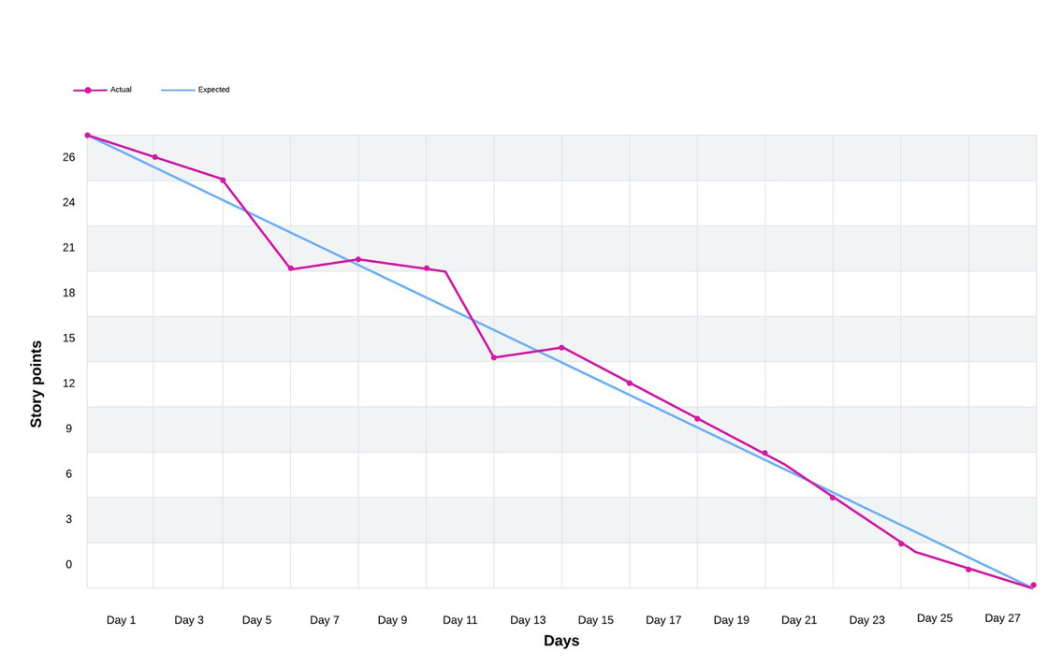
Metrics
Burn down chart

Slide 44

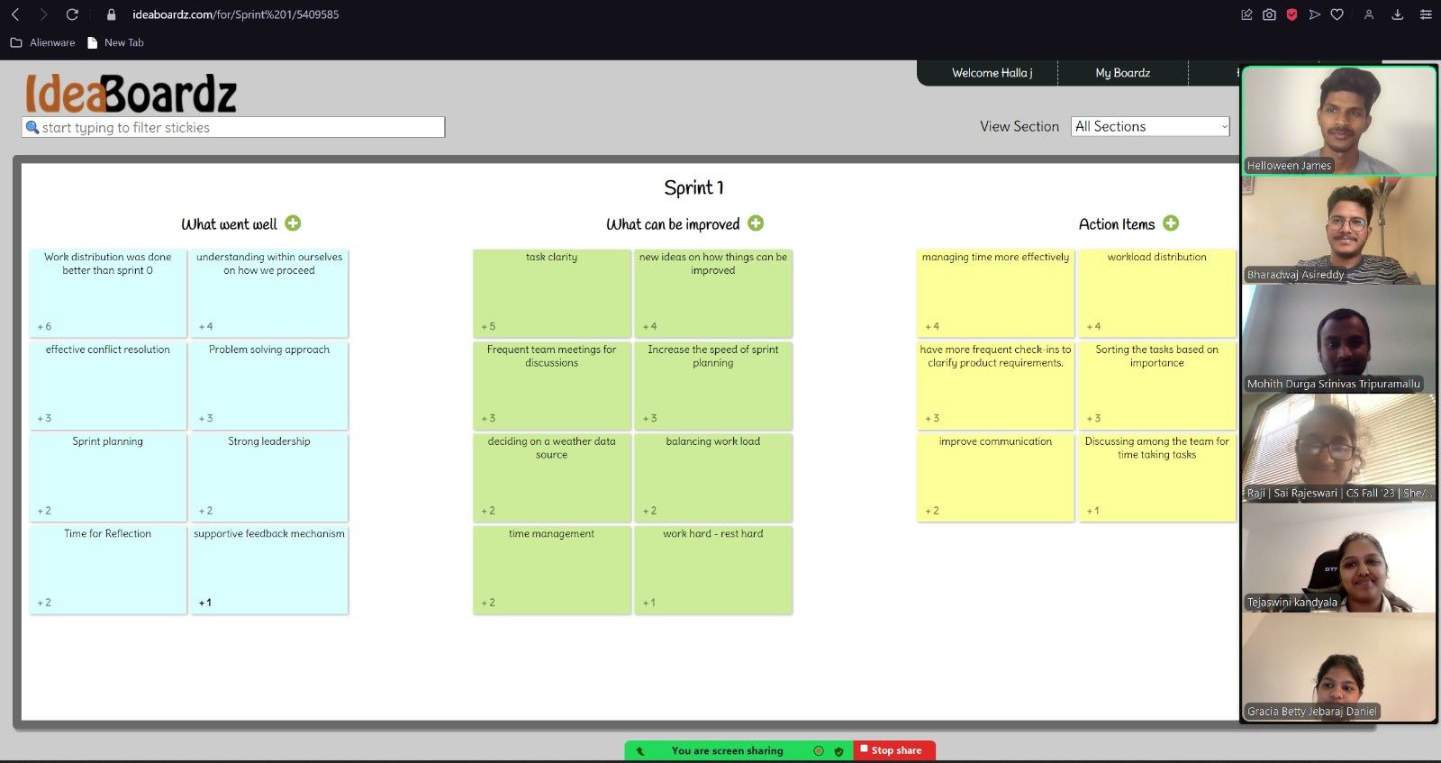
RETROSPECTIVE

Slide 45
SPRINT PLANNING

Slide 46
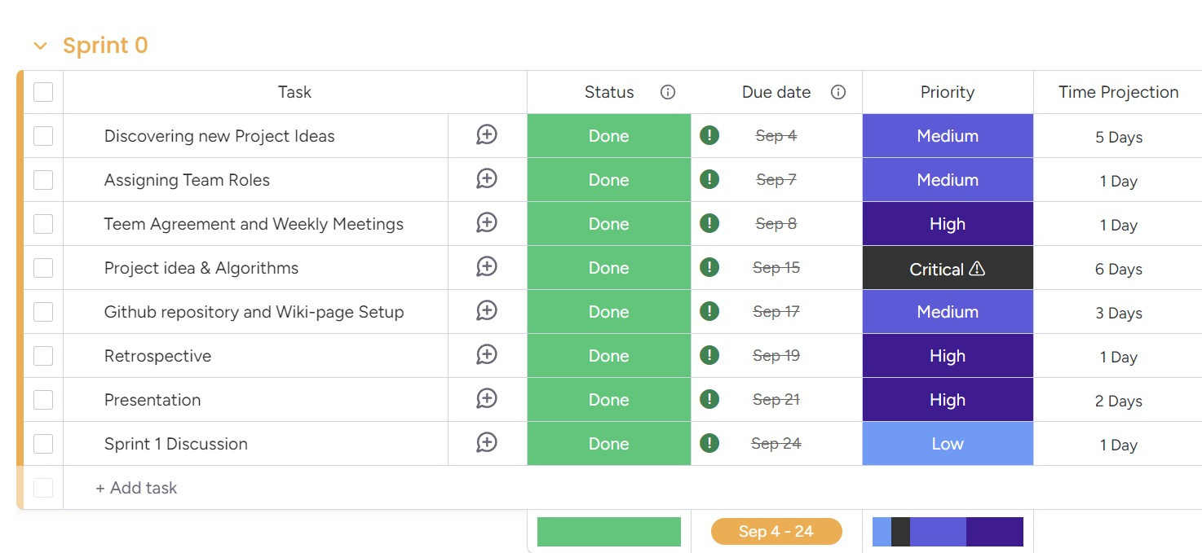

Slide 47
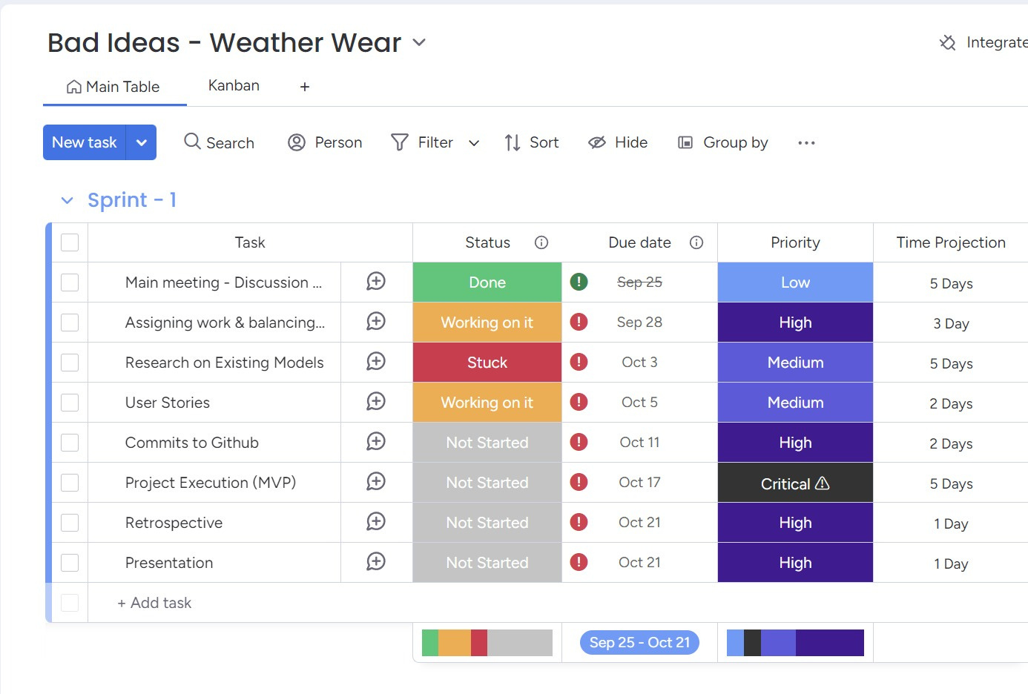

Slide 48
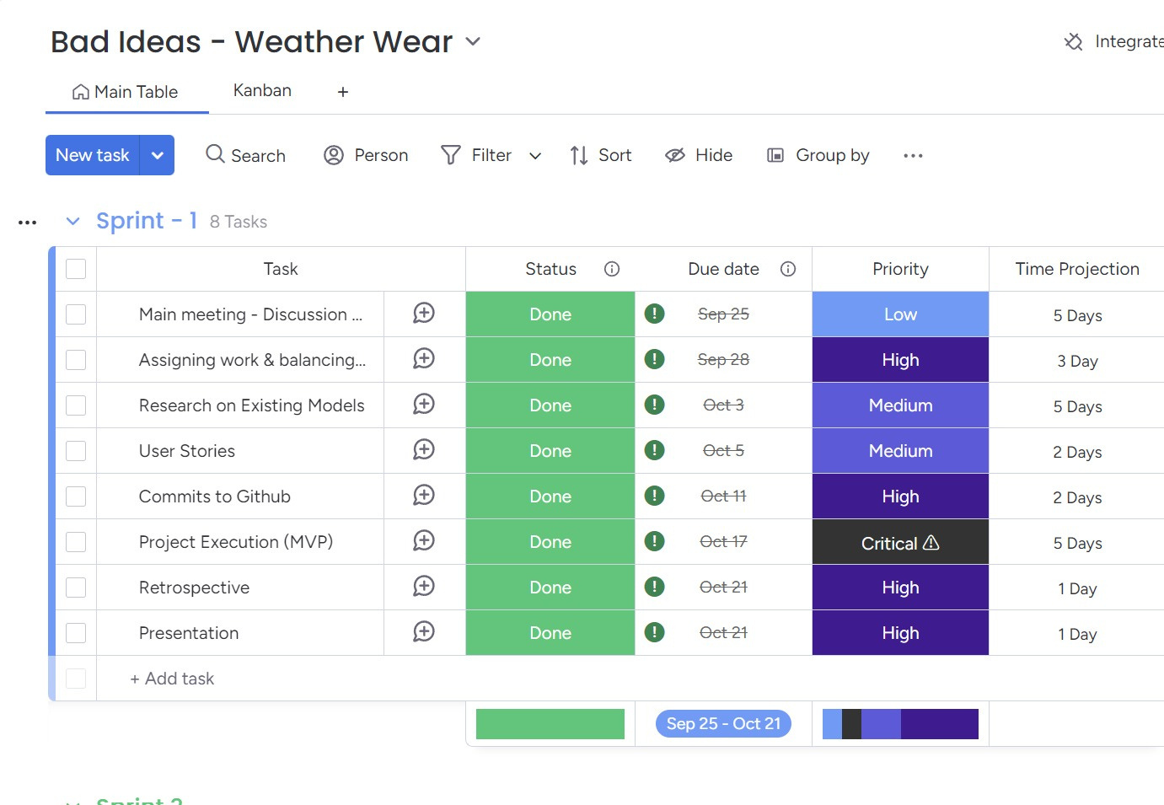

Slide 49
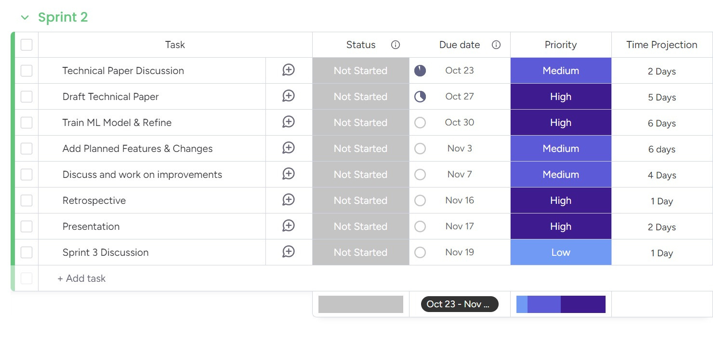

Slide 50
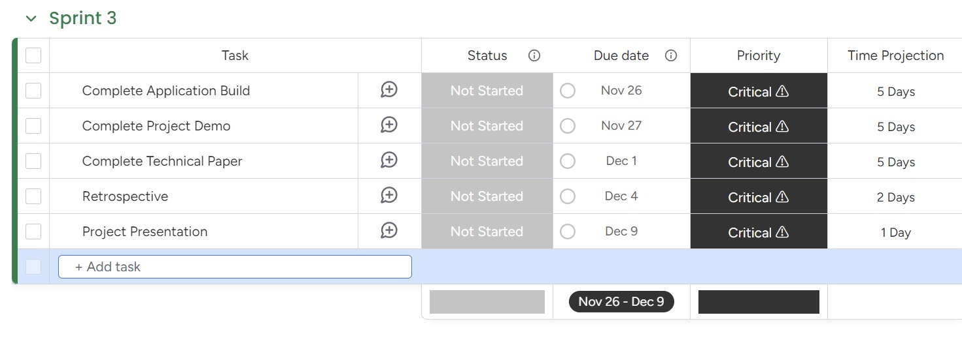

Slide 51

Sprint 2
Story ID | User Story/Task Description | Acceptance Criteria | Story Points
US6 | User Story 6: Receive outfit suggestions based on the current weather | Recommend outfit for cold weather. | 8
 |  | Recommend outfit for warm weather.
 |  | Adapt suggestions for rain.
 |  | Adapt suggestions for snow.
 |  | Adapt suggestions for wind.
US7 | User Story 7: Plan an outfit for a future date | Input future date. | 5
 |  | Display weather forecast.
 |  | Provide outfit suggestions based on forecast.
US8 | User Story 8: Customize outfit preferences based on comfort level | Set preferences for warmer outfits. | 3
 |  | Set preferences for cooler outfits.
 |  | Tailor recommendations based on preferences.

Slide 52
Sprint 2
Story ID | User Story/Task Description | Acceptance Criteria | Story Points
US9 | User Story 9: Receive clothing layer suggestions | Recommend layers for cold weather. | 5
 |  | Suggest rain gear.
 |  | Suggest cold weather accessories.
US10 | User Story 10: Check weather and outfit recommendations for multiple days during a trip | Input multiple future dates. | 8
 |  | Retrieve forecasts for multiple days.
 |  | Provide outfit suggestions for each date.
TS3 | Technical Story 3: Implement a weather forecast-based recommendation system | Integrate weather forecast data for future dates. | 13
 |  | Provide accurate outfit suggestions based on forecast.
TS4 | Technical Story 4: Build UI for future date outfit planning and customization | Add a user-friendly interface for future date selection. | 8
 |  | Add interface for customizing outfit preferences.

Slide 53
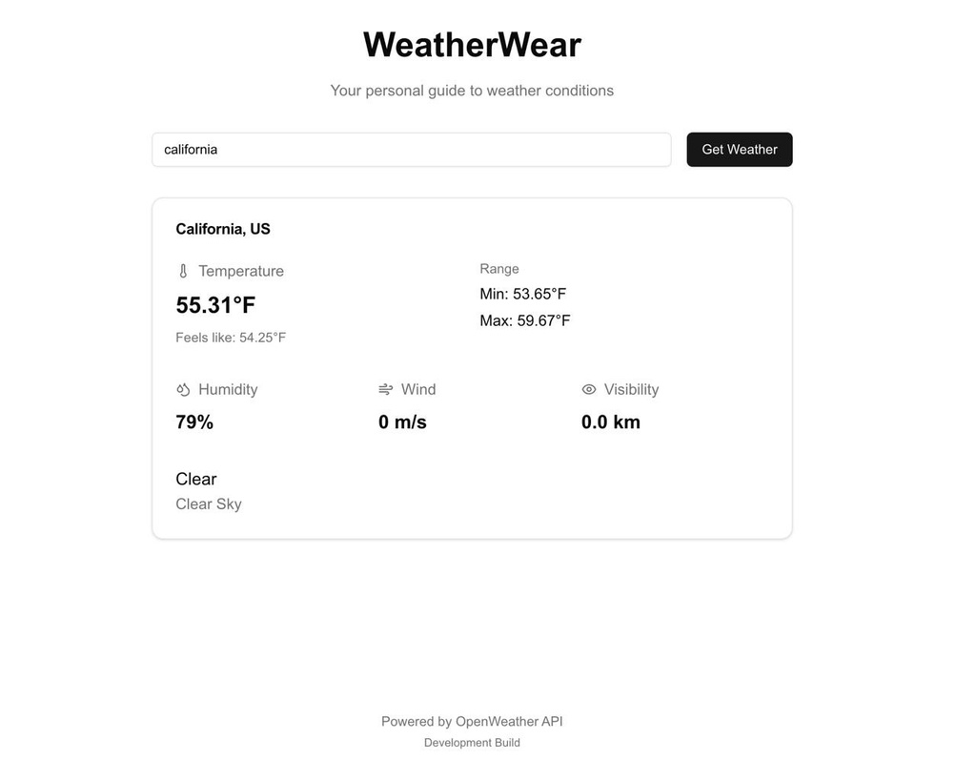
PROJECT DEMO
User Story 1 - Typing in Location Manually

Slide 54
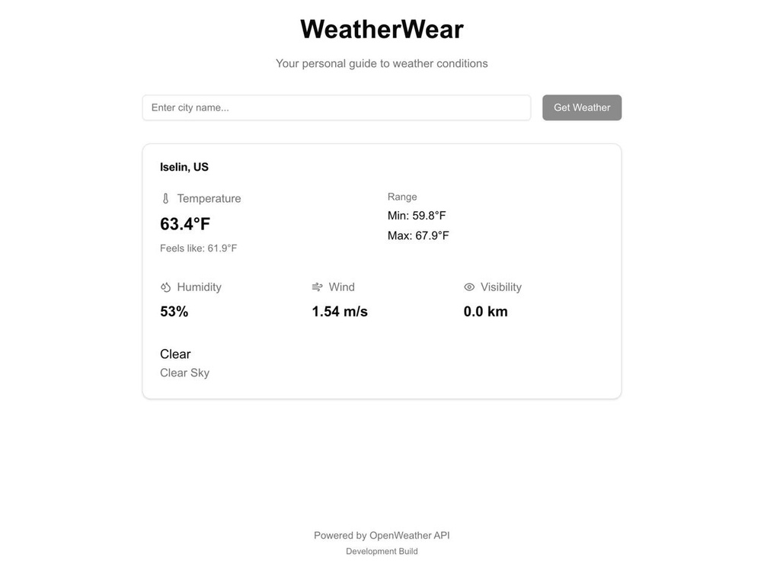
App takes Location Using GPS User story 2

Slide 55
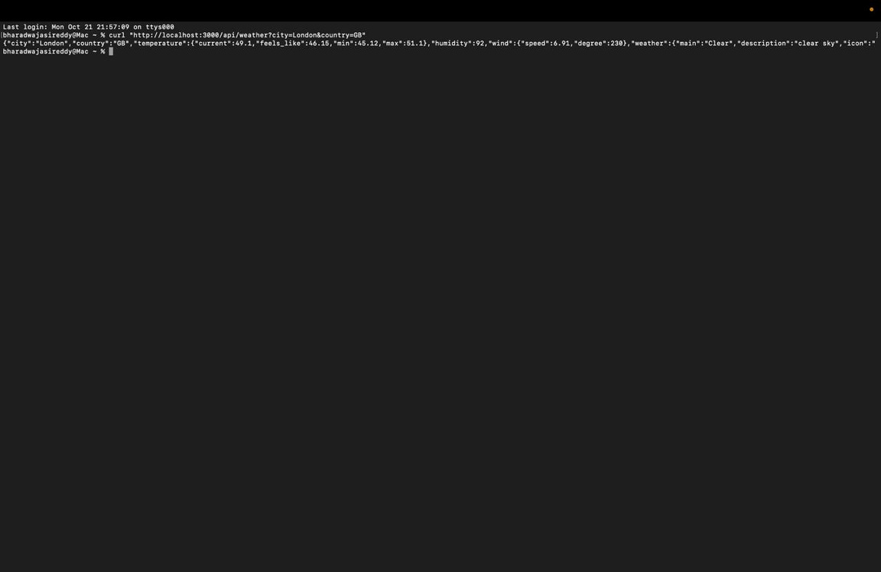
API

Slide 56
GITHUB LINK
https://github.com/htmw/2024F-Bad-Ideas/wiki

Slide 57
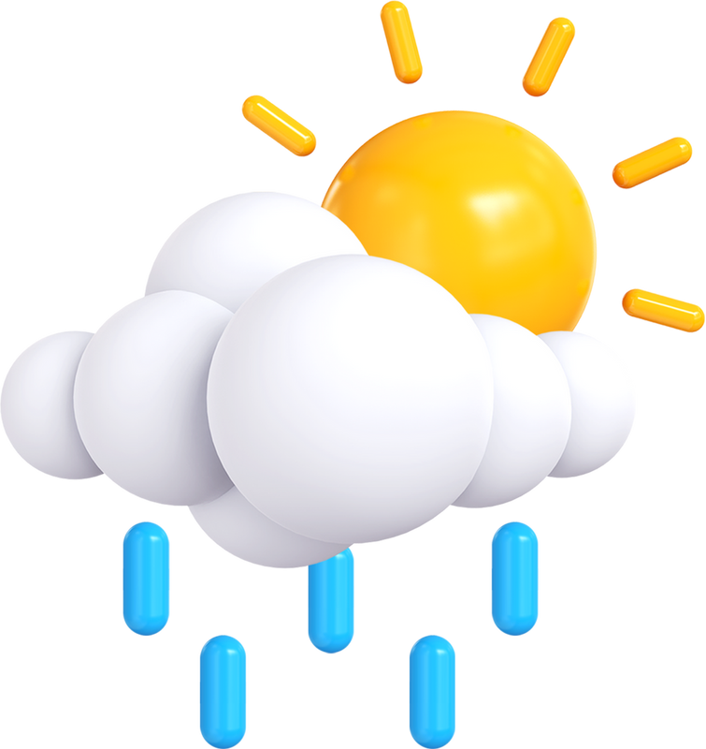
THANK YOU

